Slide 1
Partnership
VIGNESH M

Slide 2
P and Q started a business with capitals of Rs.25000 and Rs.40000 respectiveiy. Find the ratio of investments?
(a) 5:2 (b) 5:3 '(c) 5:8 (d) 5:10
A and B are the partners in fruit selling business .A invests Rs.40000 and B invests' Rs.60000 for their business. Find the ratio of their profit?
(a) 2:5 (b) 2:3 (c) 2:6 (d) 2:8
Mr. Deepak and Mr. Dharani invested Rs.18000 in a business. At the end of the year Out of a total profit of Rs. 1800 Deepak's share is Re. 750.What was the investment of Mr. Deepak ?
(a) Rs. 5000 (b) rs. 6000 c) 7500 d) 8000

Slide 3
The ratio of investments of two partners A and B is 11:12 and the ratio of their profit is ;2:3.If A invested the money for 8 months, then the time for Which B invested the money is:
(a) 3 months (b) 9 months (c) 10 months (d) 11 months
Mathi and Nandhini started a business and invested Rs.4000 and Rs. 5000 respectively, After four months Sasi joined by Investing Rs.5000. At the end of the year, there was a prom of Rs. 3700. What is the share of Sasi?
a) Rs. 1200 0)Rs.1000 c) Rs.1100 d)Rs.1400

Slide 4
A began a business with Rs. 4500 and was joined afterwards by B with Rs. 5400. When did B joind the profits at the end of the Year were divided in the ratio 2:1?
(a) After 4 months (b)After 5 months. (c) After 6 months . (d) After 7 months
Mr. Burkit started a business investing Rs.45000 .After 3 months Peter joined him with a capital of Rs.60000. After another 6 months, Ronald joined them with‘a capital of Rs'.90000. At the end of the year, they made a profit of Rs;16500. Find the ratio of their profits?
(a) 2:3:1 (b) 2:2:1 (c) 2:5:1 (d) 2:6:1

Slide 5
A started a business with a capital of Rs.2,100. After 4 months he admitted another partner B. what amount should B put In so that the profit may be divided equally at the end of the year?
P and Q enter into partnership investing Rs.48000 and Rs.60000 respectively. after 3 months, P withdraws Rs. 8000 while Q invests Rs. 6000 after 6 months of starting of business. Out of the total amount of profIt if P gets Rs. 12000 as his share, the total profit is?
(a) Rs.24000 (b) Rs.30000 (c). Rs.34000 (d) Rs.3700
Three friends A, B and c started a business by investing amount In the ratio of 5:7:6 respectively. After a period of six months C Withdrew half of the amount Invested by him. If the Profit received at the and of an year Is Rs. 33,000,what is c's share in rs. ?

Slide 6
1.Find the sum of the arithmetic series :
5+ 11 + 17 + ..... + 95 .
A. 800 B. 900 C. 850 D. 750
2.How many terms are there in the A.P. 20, 25, 30, … 130.
(a) 22 (b) 23
(c) 21 (d) 24
3. The sum of numbers between 100 and 500 which are divisible by 6 is
(a) 67 (b) 498
(c) 2010 (d) 20100

Slide 7
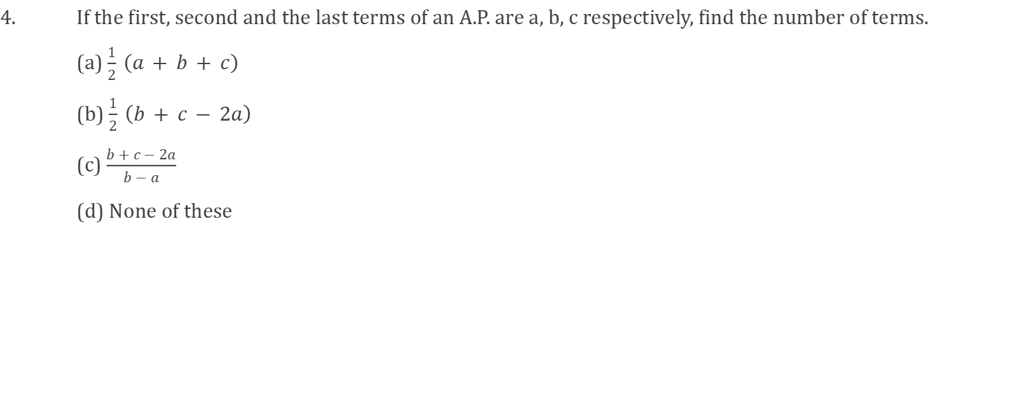

Slide 8
The sum of the first two terms of a G.P is -8 and the sum of the first four terms is -80.Find the first term and the common ratio of the G.P
Find the value G. P series a=3 ,r=2,tn=384 find the value of n

Slide 9
Fifth term of G.P is 1875 .first term is 3 find the common ratio
A. 7 B. 9 C. 5 D. 3
Find the tenth term of the sequence
1/4 ,-1/2,1,-2.........
A. 2^7 B. (1/2)^7 C. - (1/2)^7 D. -2^7

Slide 10
THANK YOU

